Slide 1
EMOTIONAL AND MENTAL HEALTH STRATEGIES
Renee White, Joplin Missouri

Slide 2
How y’all doing?
What is your proudest team accomplishment thus far?
What is your best memory or moment thus far?
What has been the hardest part of the post-disaster work for you?
What do you wish you could have done differently?
Has your experience been different than what you expected? If so, how?

Slide 3
Gauging how you are doing

Slide 4
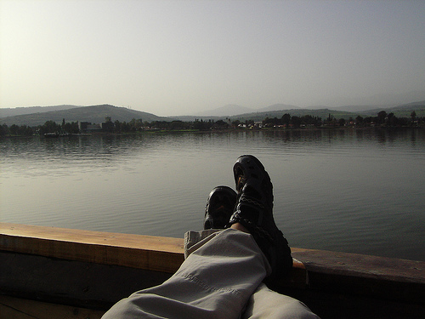
Quick Tips for Personal Well-being
The speediest way to stamp out stress is by engaging one or more of your senses—your sense of sight, sound, taste, smell, touch, or movement--to rapidly calm and energize yourself.
View a calming picture.
Listen to soothing music.
Enjoy a juicy piece of fruit.
Stop and do belly breathing.
Splash cold water on your face or wrists.
Get up and stretch.

Slide 5
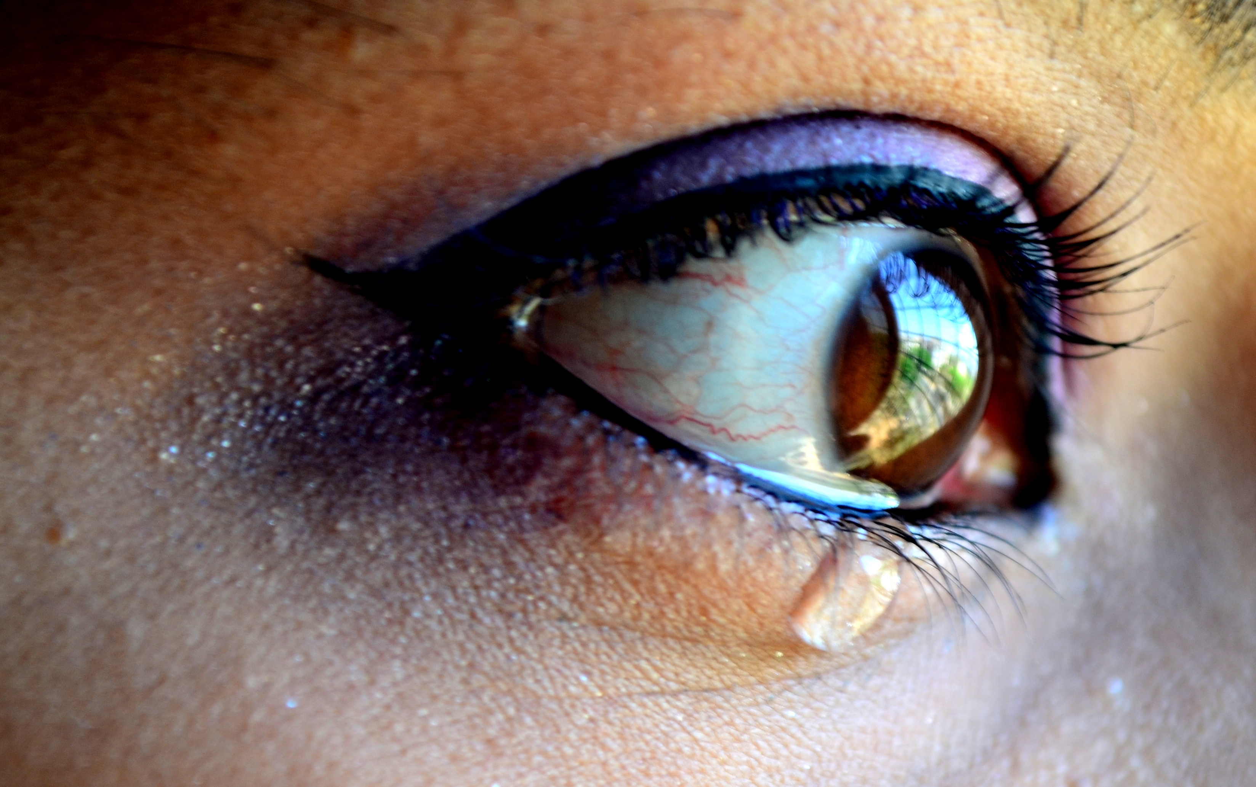
Quick Tips for Personal Well-being
Find a safe place or person with whom to share your emotions. Emotions must be felt, not just thought through.
"If the eyes are the windows to the soul, then crying is just window washing”

Slide 6
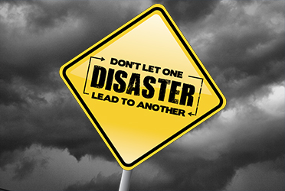
IT'S A GOOD IDEA TO SEEK PROFESSIONAL HELP IF YOU ARE:
• Having trouble functioning at home or work
• Emotionally numb and disconnected from others
• Having terrifying memories, nightmares, or flashbacks
• Using alcohol or drugs to feel better
• Avoiding things that remind you of the trauma.

Slide 7
Meaning Making
Serving others when your life has also been affected by the disaster
Survivor’s Guilt
Grief and Loss vs. Clinical Depression
Spiritual Questions

Slide 8
Quick Tips for Community Well-being ***resources listings***

Slide 9
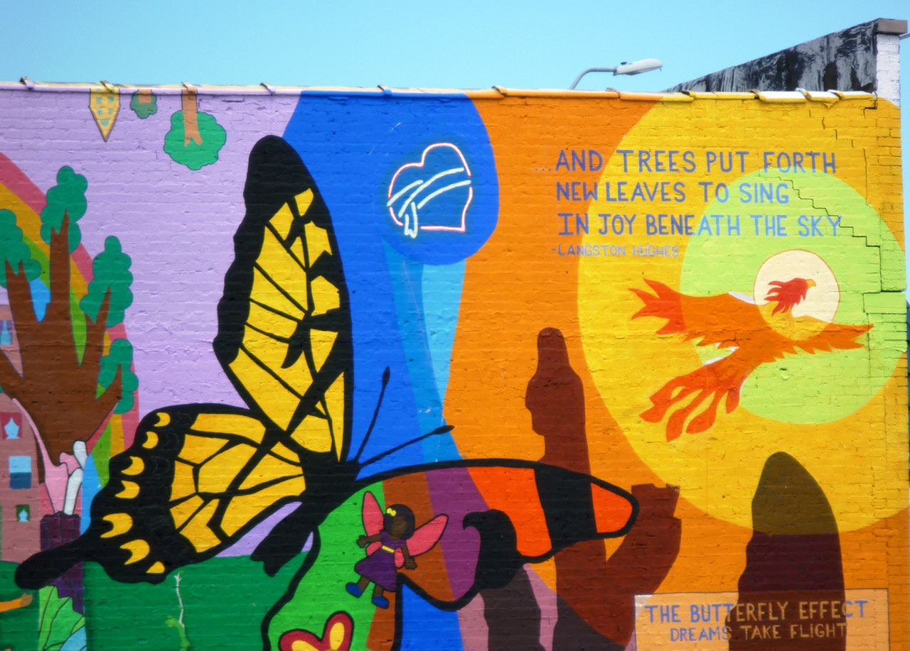
Quick Tips for Community Well-being ***rituals***

Slide 10
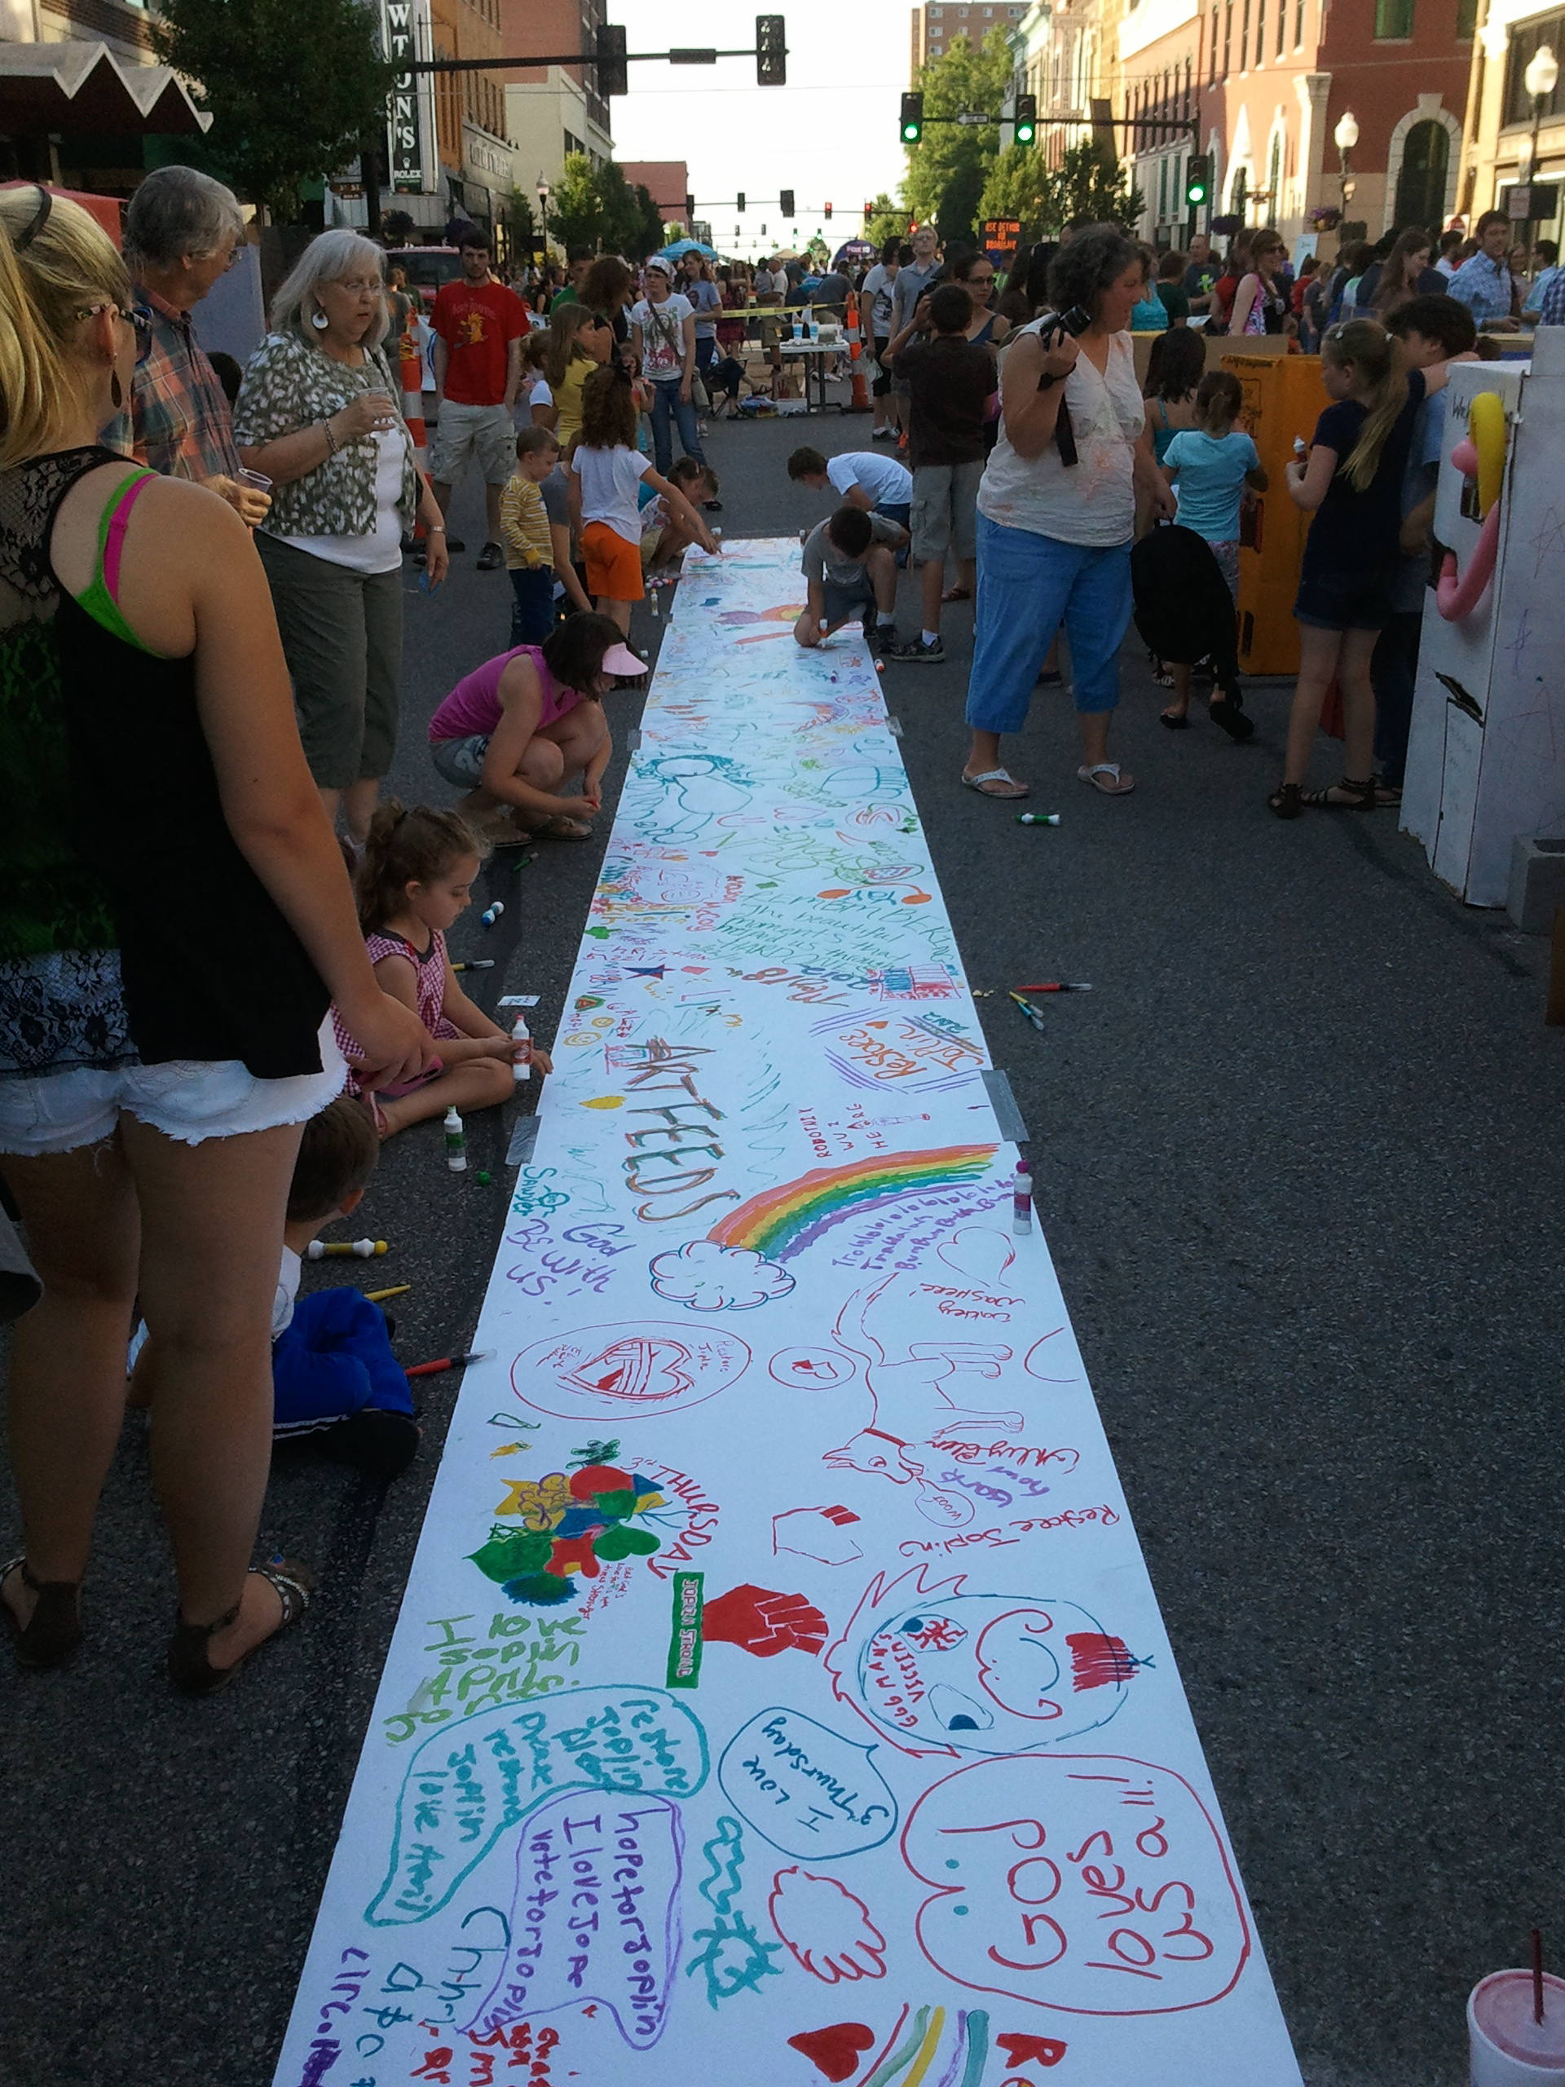
Quick Tips for Community Well-being
***involve all ages***

Slide 11
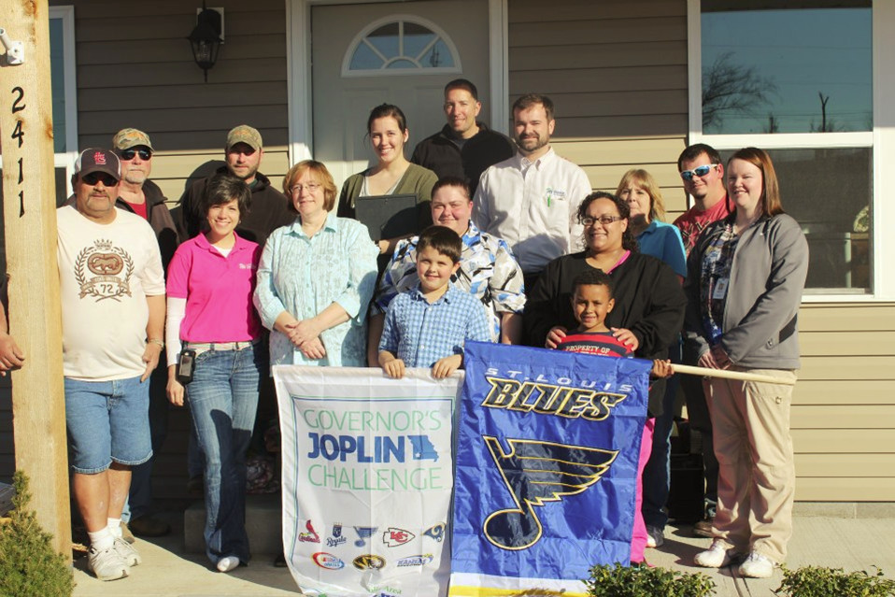
Quick Tips for Community Well-being ***ceremonies***

Slide 12
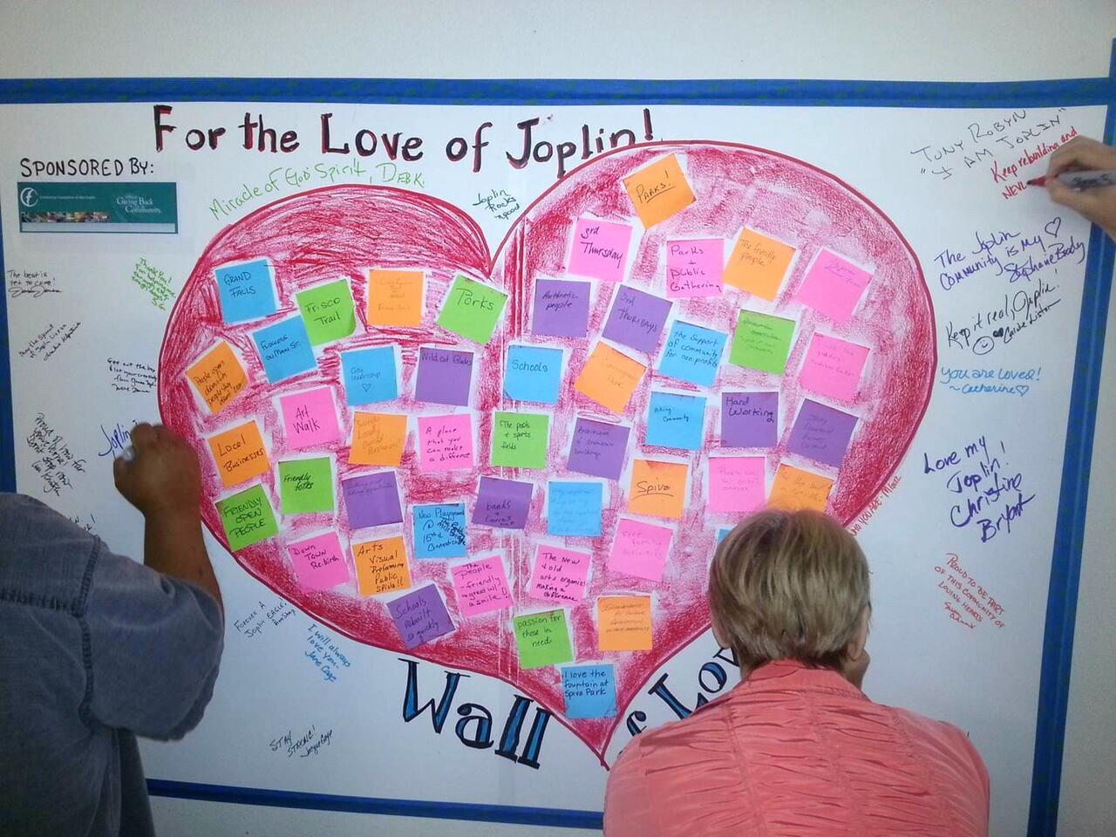
Quick Tips for Community Well-being ***marking time***

