Slide 1
Bridging the Gap for Harvey Recovery “Settling in for the Long Haul” Monday June 11, 2018 * Galveston TX
PRESENTERS:
Carlene Anders
Board Secretary & Executive Director of the Okanogan Co. Long Term Recovery Group, Mayor City of Pateros, Washington State
Robin Clegg
Board Member & San Diego VOAD Chair, CA
Executive Director of Community Recovery Team Inc.
theDLT.org

Slide 2
The LONG HAUL
Long Term Recovery
means LONG TERM!
“An event of this scale can very well take years, and in some cases it may take more than 10 years to actually fully recover from this event,” said Gavin Smith, director of the Department of Homeland Security’s Coastal Resilience Center of Excellence at the University of North Carolina.

Slide 3
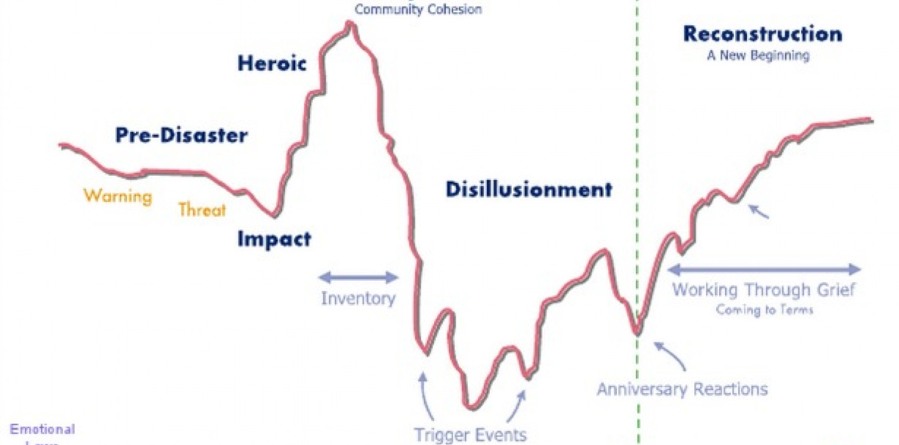
Understand the Journey
Stages of Disaster

Slide 4
EDUCATE YOURSELF
Disaster is like a whole new language
Save all resource materials you receive: access when you have capacity, not when your are saturated
- Try not to reinvent the wheel . . . Find what you need and what best fits your group
Stay open to new information & ideas, but don’t let anyone run you over
Notes:
Don’t be afraid to say you don’t know yet or we estimate, but it is only our best guess.

Slide 6
CREATE GOOD SYSTEMS, SUSTAINABLE SYSTEMS
Take the time and attention to implement systems that will save time and energy
Make sure those systems can stand up over time, even with staff changes. Be realistic.
What systems are you implementing that help you function better?

Slide 7
CONTINUE TO ASSESS
Continue to assess where you are and your progress towards the goals you have set
Adapt plans as needed, they will change
Conflict will continually resurface, know that you will be stronger for working through it

Slide 8
Expect the next challenge, road blocks
There will be more to come . . . EXPECT IT!
Take the challenges on fully and passionately
What are some of the road blocks, challenges you have experienced so far?

Slide 9
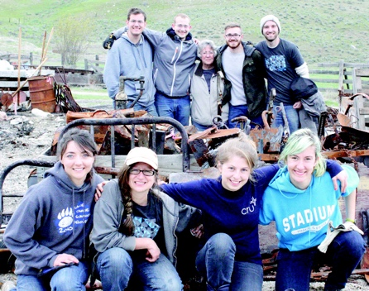
IDENTIFY YOUR SUPPORT SYSTEMS
Know who you can talk to
Know what helps you relax
High volume, high saturation . . . Consider rotating to avoid burnout. Broaden out.
Who or What are some of YOUR support systems?

Slide 10
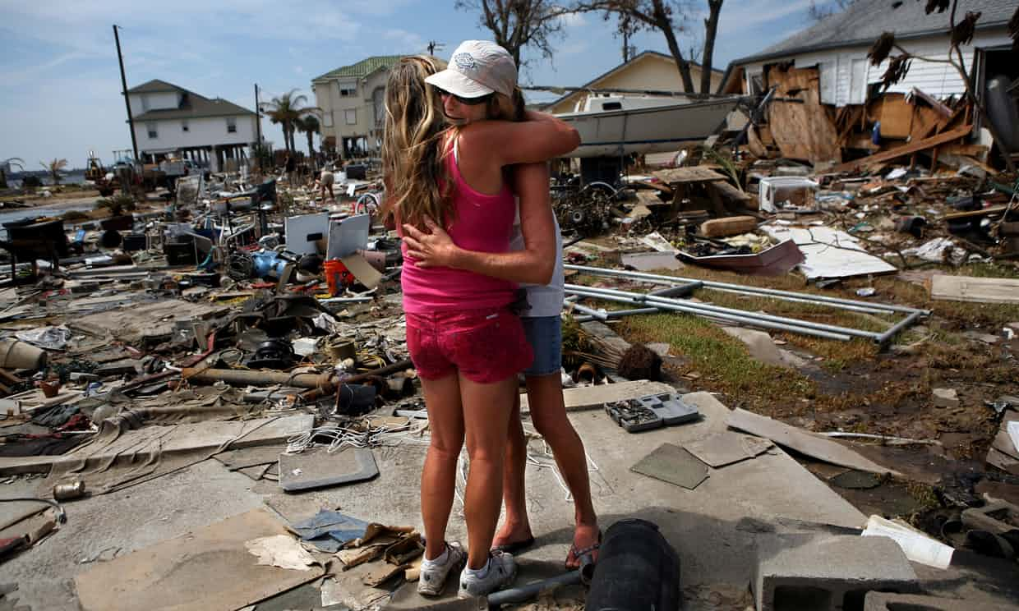
What Do You Do For Self Care?
Notes:
Questions: How many have left? How many rebuild? Total damages, number of Renters vs home owners, insurance coverage. How many have been served? Total tons of debris removed?

Slide 11
QUESTIONS?
Do what you can,
as well as you can,
for as long as you can.
YOU MAKE IT HAPPEN!
Carlene Anders – carltoncomplexrebuild@gmail.com (509) 733-0318
Robin Clegg – clegg.robin@gmail.com (619) 778-3582
http://thedlt.org

